Slide 1
SRF Developments for Compact Light Sources at JLAB
J. Mammosser Jlab SRF Institute

Slide 2
Outline
Overview of Project
Cavity R&D plans
R&D Synergies
What is Important for CLS
Collaborations
Approach for Cavity Development
Cavity Design Requirements
Cryogenic Plant
Linac Cryomodule Designs
Why Nb₃Sn ?
Why Plasma Processing ?
Test Cryomodule

Slide 3
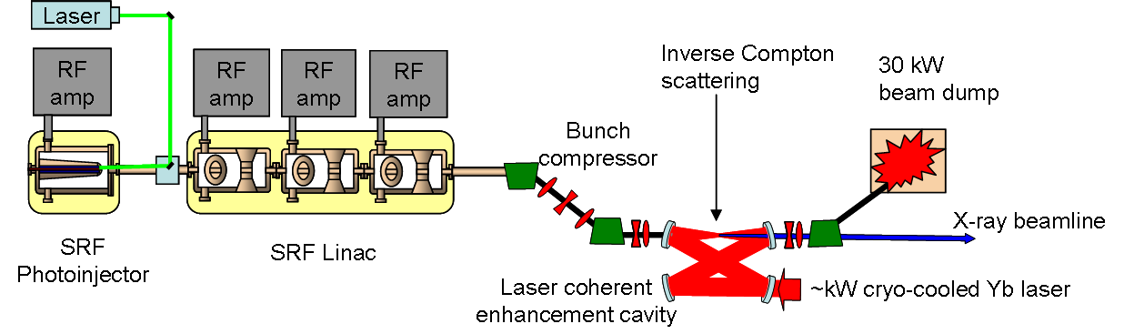
Overview of Compact Light Source (CLS) Concept
MIT developed the concept of a compact X-ray source based on inverse compton scattering. If developed this will allow universities and small research labs access to affordable X-ray experiments in-house. Goals for the R&D are to develop hardware design that produces:
High Brilliance X-Ray Source
    Size and affordability aimed at universities and research Labs for scientific and medical applications
    Complimentary to the USA Light Sources

Slide 4
Design Parameters
Electron Beam
FWHM bunch length | 300 | fs
Uncorrelated RMS energy spread | 1 | keV
Normalized emittance | 0.3 | mm-mrad
Charge per bunch | 10 | pC
Average current | 1 | mA
RMS transverse beam size at IP | 3 | microns
RMS transverse jitter at IP | 0.5 | microns
RMS timing jitter at IP | 50 | fs
RMS energy jitter at IP | 2 | keV
Linac Accelerator
Injector Gain | 4 | MeV
Accelerator Cryomodule Gain | 20-25 | MeV
Number of Cryomodules | 1
Number of Cavities | 2-4
Frequency | 352 | MHz
Operating Temperature | 4.5 | K
RF Amplitude Stability | 0.1? | %
RF Phase Stability | 50? | fs
Cavity Type | Spoke or Elliptical
? – will come out of the beam dynamics studies

Slide 5
Cavity R&D Plans
Jlab submitted an R&D proposal to BES, jointly written with MIT for developing SRF linac portion
July 2011, BES awarded funding to Jlab to carryout a 5 year R&D plan (1.8M$/yr)
  R&D will focus on the cavity designs and show proof of principle demonstration towards the proposal goals of CLS
  Develop concepts for the SRF linac (Cryoplant, RF systems, Cryomodule)
  Demonstrate cavity performance in a test cryostat
An R&D plan has been developed focusing on the following:
  Develop Novel cavity structures and cryostat packaging optimized for 20-25MeV accelerating gain (SRF Linac Design)
    Compact accelerating components
    Efficient and affordable operating costs

Slide 6
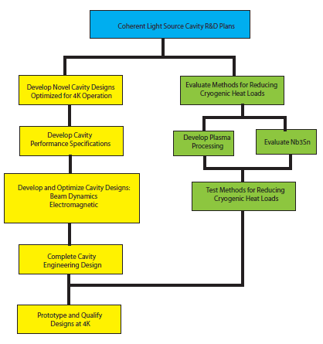
Cavity R&D Plans

Slide 7
R&D Project Synergies at JLab
CLS project has synergies with other ongoing SRF projects and by combining efforts we can maximize gains for both
Some examples of ongoing R&D with CLS synergies
  Plasma cleaning of niobium cavities is being develop at Jlab and SNS for applications towards in-situ cleaning of cryomodules (NP funded) will demonstrate reduced cryogenic losses through reduction of field emission and reduction of surface oxides. CLS plasma R&D will focus on reduction of multipacting
  Low cost cryostat development (ARRA funded project) will help with the understand and reduction of cryostat costs that could be used in the test cryostat

Slide 8
What is Important for CLS?
Linac Operating Cost
  The long term operating costs of the accelerating linac either normal conducting or superconducting designs are significant
    Normal conducting dominated by RF power requirements
    Superconducting linac case operating costs are dominated by the cryogenic plant size and operating temperature
    Jlab will be focused on a superconducting linac design and R&D and component designs will be focused on optimization for reducing the cryogenic equipment and their operating costs
Linac Hardware Costs
  Cryoplant and Cryomodule designs are complicated and costly

Slide 9
What is Important for CLS?
Reducing Cryoplant Operating Costs Requires:
  Reducing SRF Linac Heat Loads → thus reducing the required cryogenics plant size, which are packaged in specific sizes in industry. Reducing heat loads requires:
    Optimizing the cavity design and operating point, higher operating temperature
    Lowering the cavity design frequency to take advantage of lower surface losses
  Down side to these reductions can be increased linac length

Slide 10
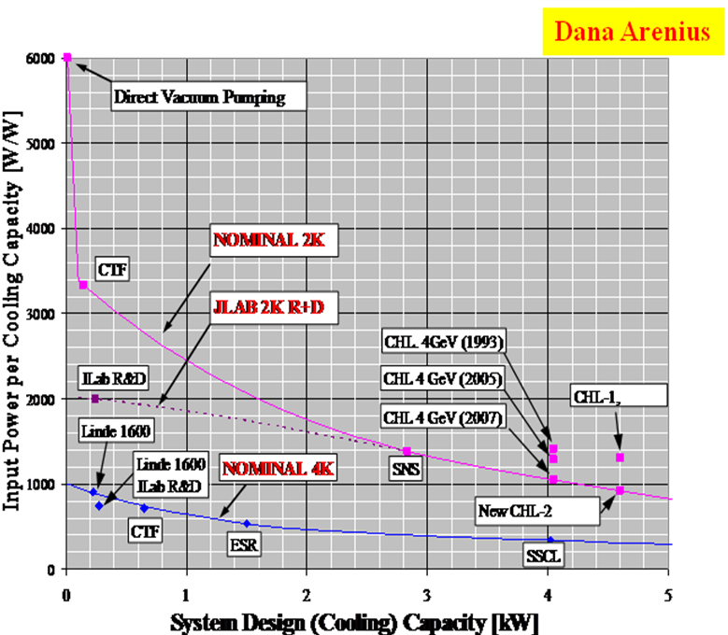
Affordable and Efficient Accelerator
D. Arenius Jlab
10M$
30-50M$
2-4M$
$1M
Small Accelerators Benefit from 4K operation
Reduced operating costs and reduce plant costs
Large accelerators require large capacity cryogenic plants
Operation at 2K makes sense

Slide 11
Reducing Heat Loads
Dynamic heat loads are driven by RF heating on the cavity surfaces
Rs = R_{BCS}(T) + Ro
  Qo = ω₀ U / Pc
BCS Theory:
Rs increases with the square of the rf frequency
Rs decreases exponentially with temperature
Pc = ½ Rs ∫_{v} |H|² dv
Requirements:
Reduce frequency Larger structure
Lower temperature Higher Cost

Slide 12
Project Organization
Beam Dynamics Studies – (G. Krafft, Y. Roblin, F. Hannon, B. Graves MIT)
Cavity Design – Design, fabricate and demonstrate cavity prototypes (R. Rimmer, , H. Wang, F. He)
Cryostat Design Concepts – Develop low cost cryostat concepts, design and fabricate test cryostat (M. Wiseman, K. Wilson, K. Smith)
RF System Concept – Provide RF testing hardware and CLS hardware concept (A. Kimber, C. Hovator, T. Powers, T. Plawski)
Nb₃Sn Development – Demonstrate reduced cryogenic losses on samples and simple RF structures (G. Eremeev, P. Kneisel)
Plasma Cleaning - Study and develop procedure for reducing SEY on niobium surfaces (S. Popovic ODU, S. Ahmed)

Slide 13



Collaborations
MIT will assist in the analysis of the cavity designs towards meeting beam dynamics requirements and provide guidance where necessary towards CSL goals
ODU Accelerator Center / Physics department will perform R&D towards reducing cavity multipacting through plasma cleaning and is providing students
SNS/ORNL is collaborating on in-situ plasma cleaning of SRF cavities

Slide 14
Approach for Cavity Development
In order to reduce cryogenic losses we looked at a frequency for the cavity design that was already established
  352Mhz was chosen for the cavity that would require 176MHz for the injector cavity (not part of this project)
Cavity design would be beta =1 to be efficient, 2-3 cavities would be required at this frequency
Cavity type could be elliptical or spoke type designs
  Elliptical has advantages with better emittance but suffers from larger size. Analysis is underway to quantify the beam dynamic performance of both designs.
  Spoke cavity should have better stability (more rigid) against microphonics and smaller diameter.

Slide 15
Approach for Cavity Development
For this project we have develop an elliptical and spoke cavity design and will analyze them for RF and beam dynamics performance.
  Results so far show similar RF performance when optimized, beam dynamics studies of both designs are now underway
Elliptical cavity design, fabrication and RF performance is well known, less experience on spoke cavities
Jlab will prototype the spoke cavity design (where we have the least experience ) and evaluate its performance against the elliptical counterpart. Then we will decide which is best for the CLS applications and demonstrate at 4.5K

Slide 16
Cavity Design Requirements
Analyze 2 and 3 cavity configurations for 20-25MeV energy gains
Keep the total dynamic RF losses of the cryomodule cavities at 90W or below at gradient operating point
Evaluate Spoke and Elliptical designs optimized for 4.5K operations
Demonstrate two of the chosen cavity designs in a test cryostat operating at 4.5K

Slide 17
Current Spoke Cavity Performance
Test data of ANL’s 345 MHz spoke cavity, beta=0.63 for three different temperatures

Slide 18
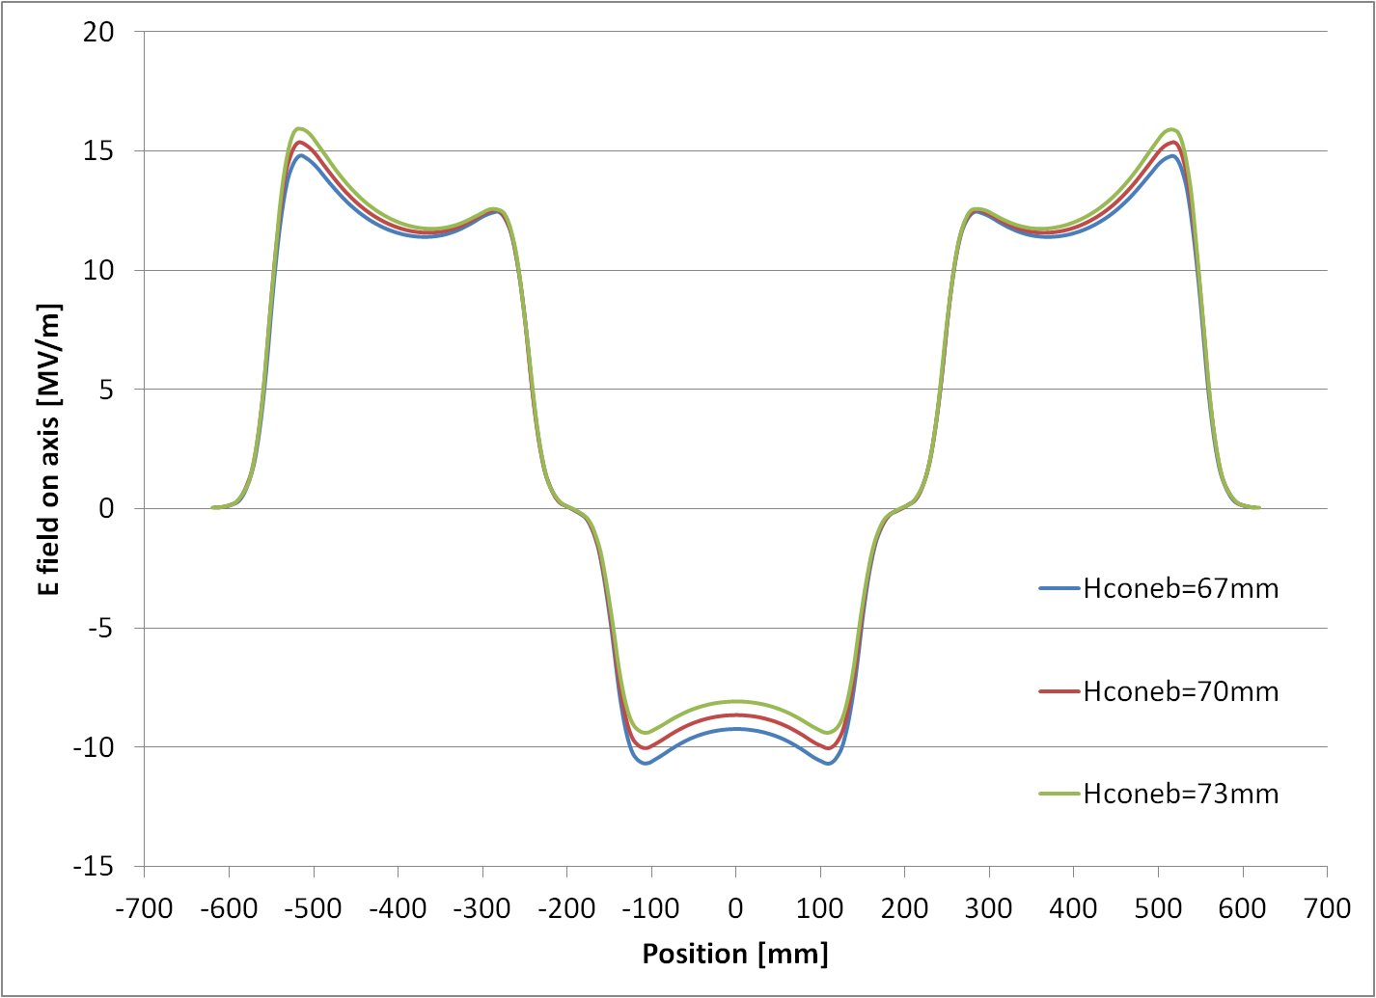
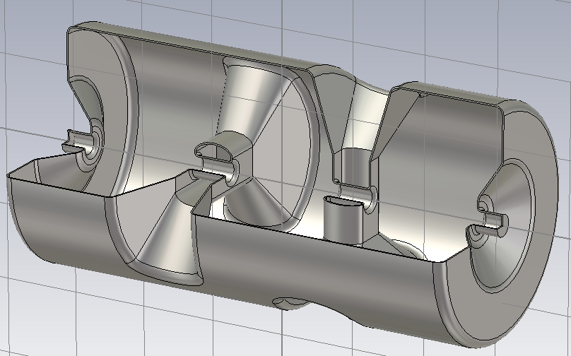
F. He
Reducing Ep on cost of Rs*Ra
Keeping iris to iris distance fixed, and reducing end-cone height, to make field move to the central gap.
Ep is at end cone, so it is reduced.
Hconeb[mm] | 76 (origin) | 73 | 70 | 67
Diameter[mm] | 600.5 | 601.1 | 602.2 | 603.3
G [Ω] | 192.3 | 191.4 | 191.6 | 189.7
R/Q [Ω] | 727.2 | 727.4 | 727.2 | 726.5
G*R/Q [Ω²] | 1.398x10⁵ | 1.392x105 | 1.385x105 | 1.378x105
Ep [MV/m] | 24.4 | 23.2 | 22.4 | 20.3
Bp [mT] | 40.8 | 40.8 | 41.6 | 41.4
Note: CAD model, omaga3p results. Ep and Bp at Va = 7 MV Error of surface fields are estimated to be ±1 MV/m and ±1 mT
Fixed
Hconeb

Slide 19
Reducing Cavity Costs?

Slide 20
Cryogenic Plant
Design Assumptions
  Cryogenic plant must provide 4.5K capacity for Injector cryomodule and Linac cryomodule
  Cryogenic plant should be packaged for a standard plant size LR70 130-190W
    110 W cryogenic losses linac (90 dynamic+20 static)
    60W cryogenic losses injector (40 dynamic + 20 static)
    20W operating overhead
  190W Total
  Linac cryomodule should be optimized to reduce cryogenic heat loads
    Thermal shield will be cooled with liquid nitrogen to reduce cost
    Penetrations in cryostat should be minimized to reduce losses and cost
    Cryogenic circuit should have optimized thermal intercepts and use return gas to reduce piping losses

Slide 21
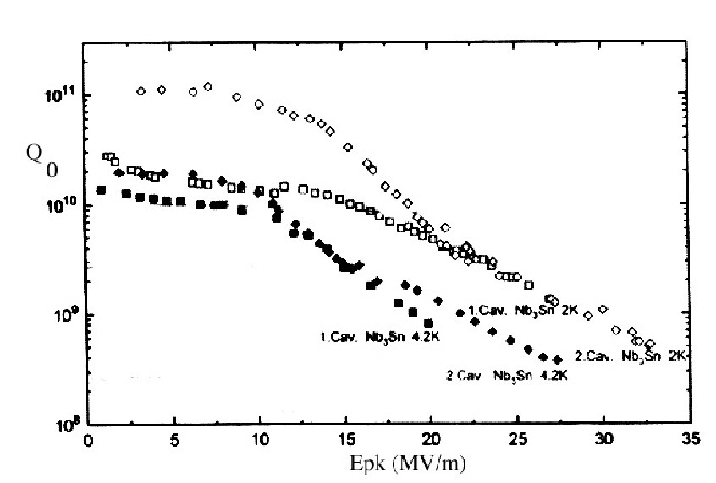
Why Nb₃Sn?
1.5Ghz Elliptical SS at 4.2K
Nb₃Sn
G. Muller and P. Kneisel
350MHZ
Spoke Cavity
at 4.2K
A factor of 10 gained in Qo low fields
But Qo drops at higher fields

Slide 22
Nb₃Sn R&D
R&D focus will be aimed at producing Nb₃Sn films and developing an understanding of increased losses at higher fields.
  Establish the recipe used at Wuppertal University
  Study losses by applying the film to a documented single cell elliptical cavity and use thermometry diagnostic test hardware to develop an understanding
  Perform vertical RF tests on cavity at 2 K and 4 K

Slide 23
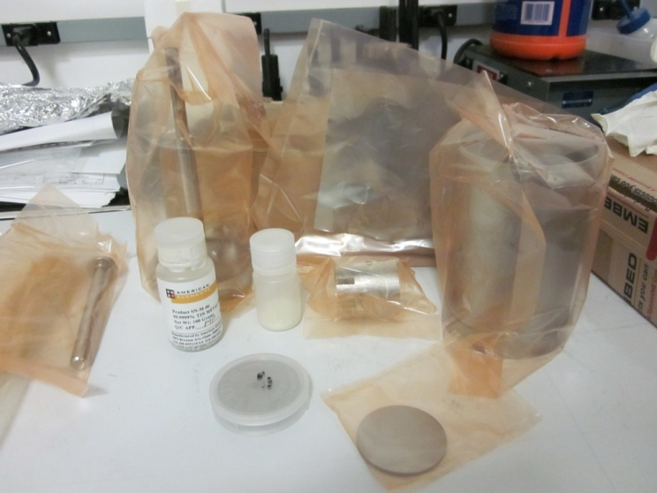
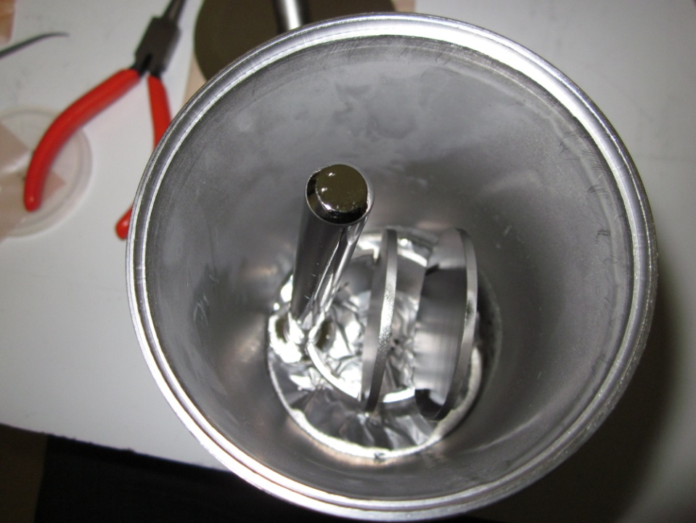
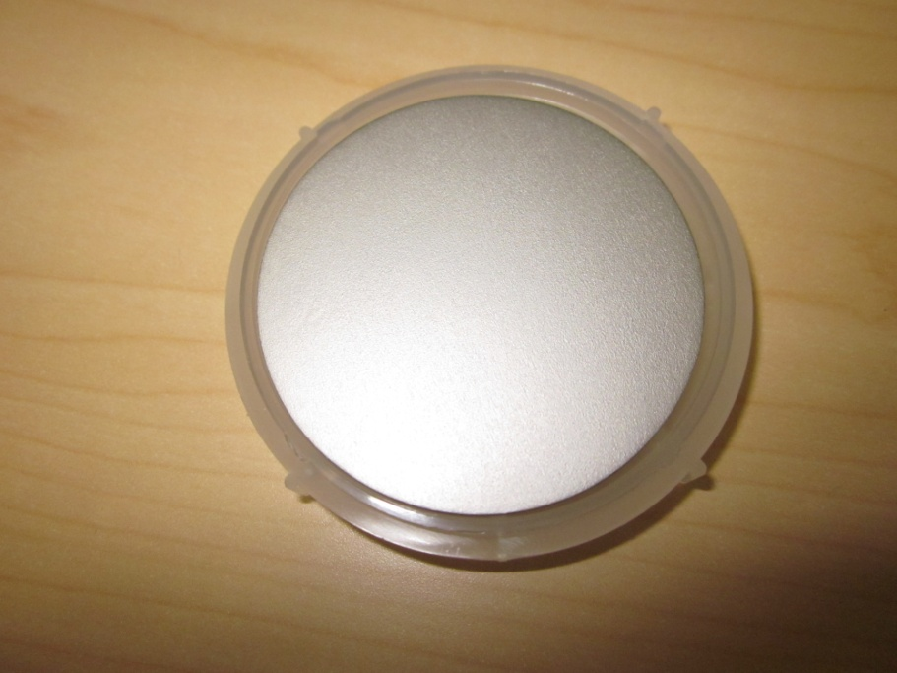
Progress On Nb3Sn
G. Eremeev
First Nb₃Sn samples produced at Jlab with Wuppertal Procedure
Analysis to follow to see if properties are correct

Slide 24
Why Plasma Processing?
We started to look at plasma processing to improve cavity performance (S-H Kim, J. Mammosser SNS, 2008)
  Benefits are large
    Reduces field emission (Pc reduces)
    Cleans RF surfaces (stable vacuum and reduced trips)
    Inexpensive way to increase gradients limited by surface contaminates
    Potentially it can
      Reduce Q-disease
      Strip bad oxides
      Clean complicated surfaces
Lightly processed a fully assembled cryomodule
  Impressive results!!
Plasma Cleaning is well established industrial process

Slide 25
Cryomodule Costs
A major cost of the linac is driven by the cryoplant and SRF accelerating cryomodule
  Our focus for this R&D is to try to significantly reduce the costs
    Lower the capacity needed for the cryoplant as small as possible
    Lower the cost of the cryomodule by simplifying the design
  Cryostat Approach
    Analyze the costs of past projects (70 cryomodules built at Jlab)
    Work on reducing the cost drivers
  Typical 8 cavity cryomodule costs around $3M today’s dollars
  Drivers are cryomodule assembly labor (due to complicated designs) and cavity string hardware (cavities and coupler hardware)

Slide 26
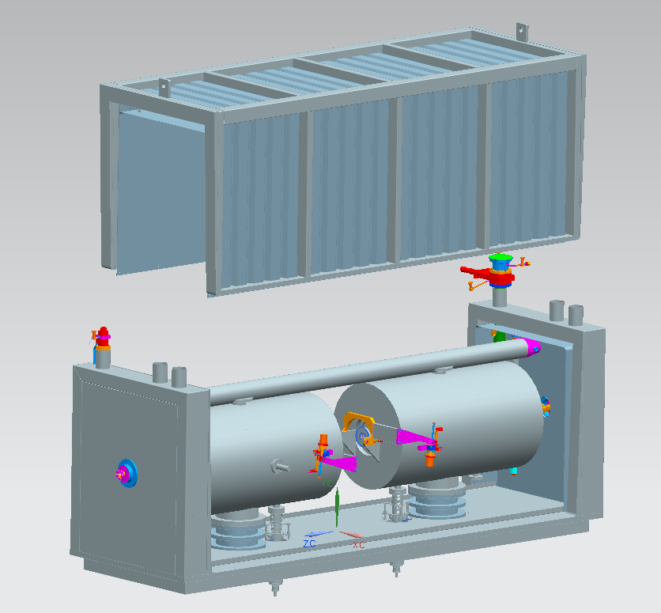
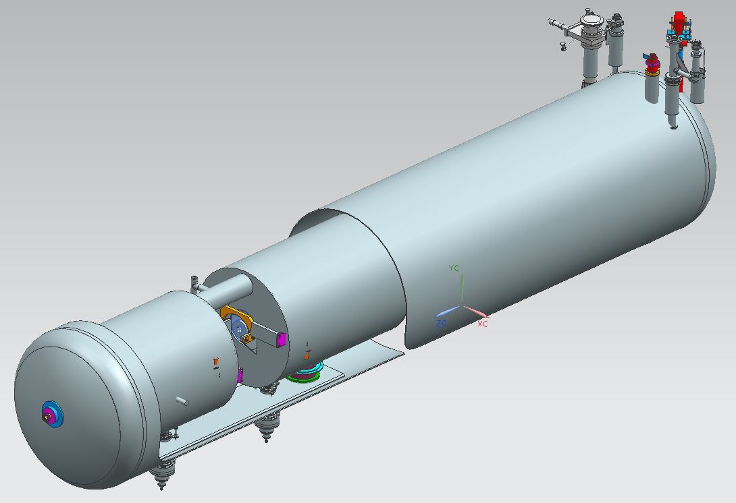
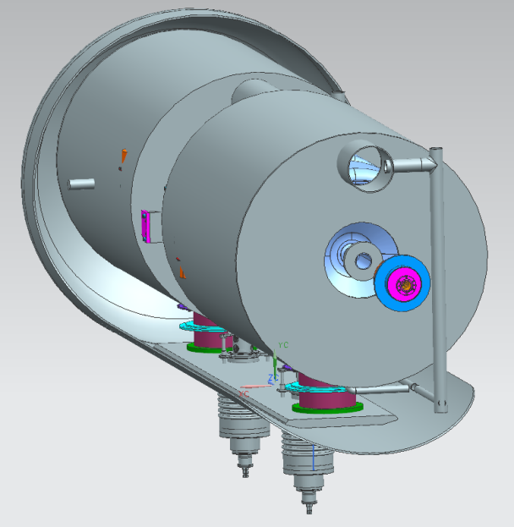
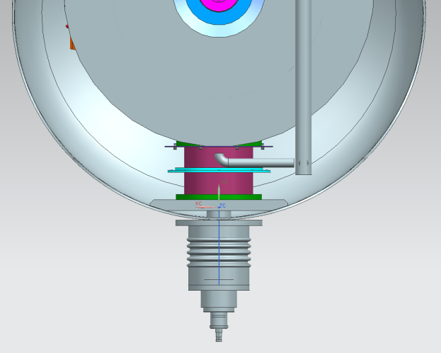
Developing a Low Cost Cryomodule Design
Reviewed cryomodule types
  Top Loaded
  End Loaded
  Bottom Loaded
Two designs are being developed and costs compared
Bottom Loaded
End Loaded

Slide 27
Conclusion
R&D is being carried out at Jlab for the development of the CLS SRF linac
Spoke and elliptical cavities will be evaluated, successful design will be demonstrated at 4.5K
Synergies with other projects will help CLS (Plasma cleaning and low cost cryostat development)
Additional R&D on Nb₃Sn is underway to investigate reducing dynamic heat loads and the cryoplant infrastructure

